Slide 1
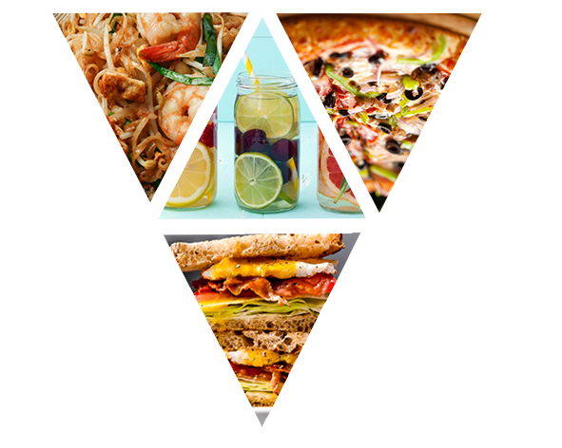
Meal Price Optimization
½ Consulting, lnc.
Group 1:
Qiuxia Chen (Katalia)
Xuechen He (Celia)
Mei Lu (May)
Junkai Zhong (Caesar)

Slide 2
Background
Structure
Data Analysis
Modeling
Conclusion

Slide 3
Background
Multiple Regions and Cities
Various Fulfillment Centers
Meal Delivery Company
Dispatching Meal Order
14 Meal Categories, 4 Cuisines – 51 Meal IDs

Slide 4




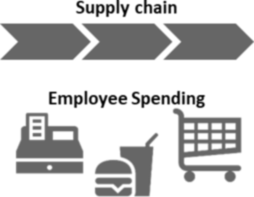





Industry Overview
Physical Footprint
Economic Footprint
15,000
Distribution centers
$280 billion
Industry annual sales
Texas, California, and Florida are leading states
Approximately the GDP of Louisiana
288 million
Square feet of distribution space
350,000
Employed by industry
Equivalent to 5,000
football fields
5.25 percent of all wholesale jobs
8.7 billion
Cases delivered
Nearly 24 million cases per day
700,000
Ancillary jobs
Industry + ancillary jobs = population of Delaware
3.2 billion
Vehicle miles per year
Around the Earth 330,000 times, or 1,700 roundtrips to the sun
$51 billion
U.S. GDP
820 million
Gallons of fuel per year
0.25 percent of the total
U.S. economy
More than 1,240 Olympic-size swimming pools
131,000
Drivers
$14 billion
Federal, state, and
local tax revenues
3.75 percent of all truck drivers in the U.S.
$7.2 billion in federal taxes, and $6.9 billion in state and local taxes
www.ifdaonline.org/economicimpact

Slide 5
Data Overview
Variable | Definition
id | Unique ID
week | Week No
center_id | Unique ID for fulfillment center
meal_id | Unique ID for the meal
checkout_price | Final price including discount, taxes & delivery charges
base_price | Base price of the meal
emailer_for_promotion | Email sent for promotion of meal
homepage_featured | Meal featured at homepage
num_orders | (Target) Orders Count
Variable | Definition
center_id | Unique ID for fulfillment center
city_code | Unique code for city
region_code | Unique code for region
center_type | Anonymized center type
op_area | Area of operation (in km^2)
Variable | Definition
meal_id | Unique ID for the meal
category | Type of meal (beverages/snacks/soups…)
cuisine | Meal cuisine (Indian/Italian/…)

Slide 6
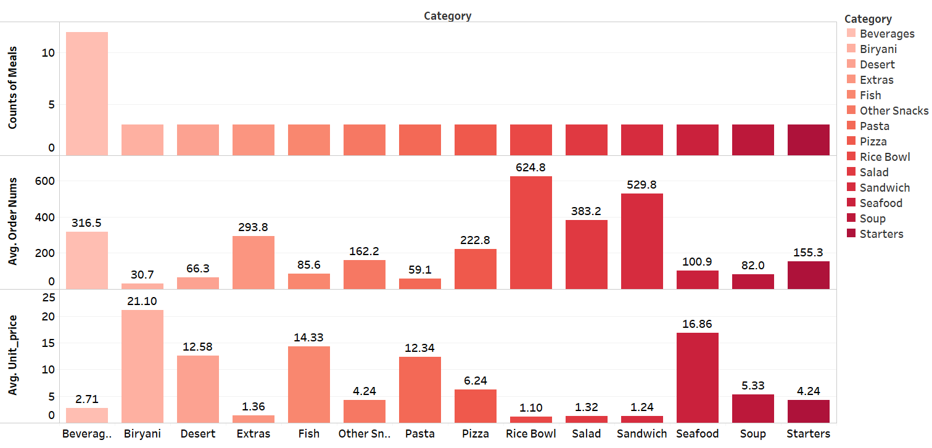
Exploratory Data Analysis: by Category
12
3
3
3
3
3
3
3
3
3
3
3
3
3
14 categories, 51 meal products
Most popular meal: Rice Bowl, Sandwich and Salad
Most expensive meal: Biryani, Seafood and Fish
The order numbers seem to be negatively correlated with the unit price

Slide 7
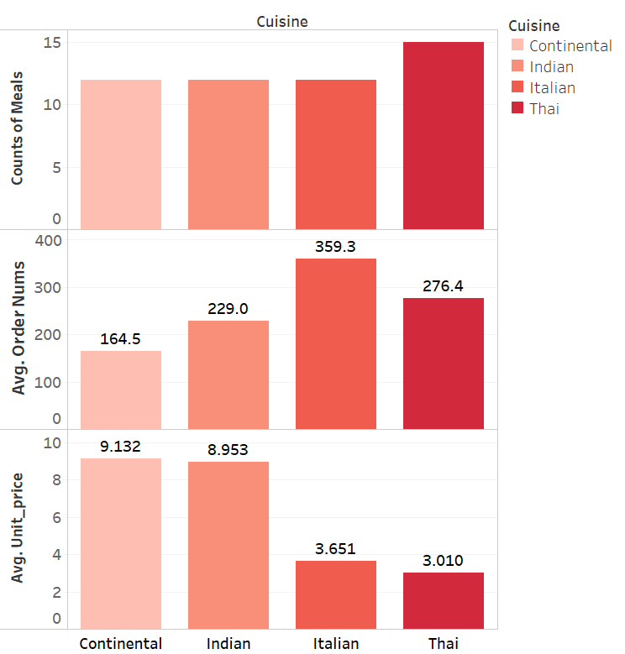
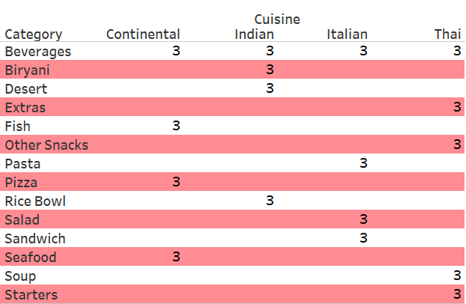
Exploratory Data Analysis: by Cuisine
15
12
12
12
Category- Cuisine combination
4 cuisines
Order numbers: Italian > Thai > Indian > Continental
Unit price: Continental > Indian > Italian > Thai
Beverage 4 favors, other categories belong to one specific cuisine
Each cuisine contain 4~5 different kinds of meals

Slide 8
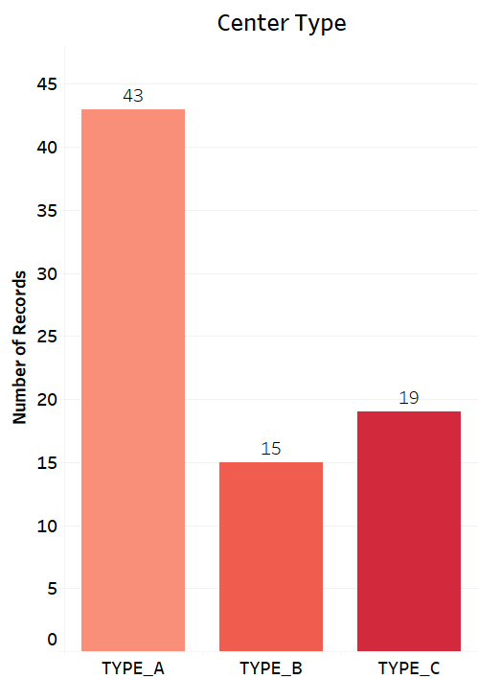
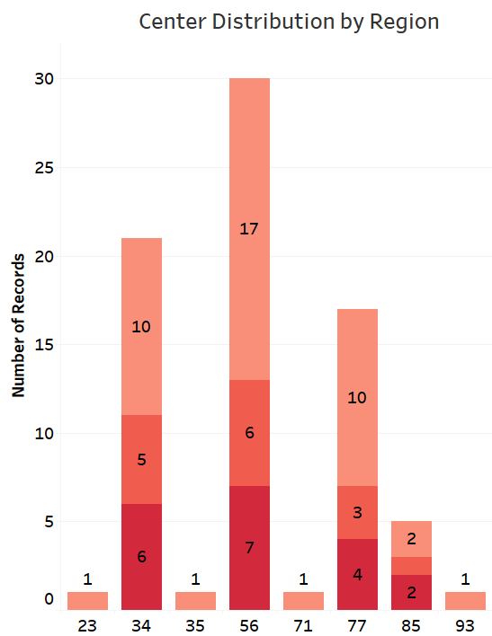
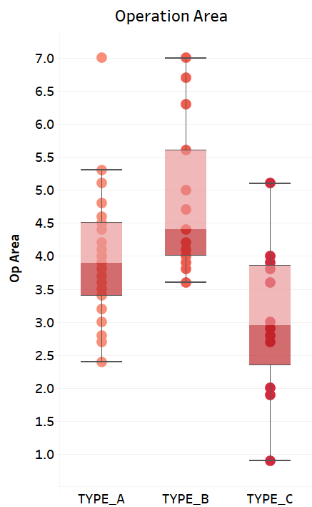
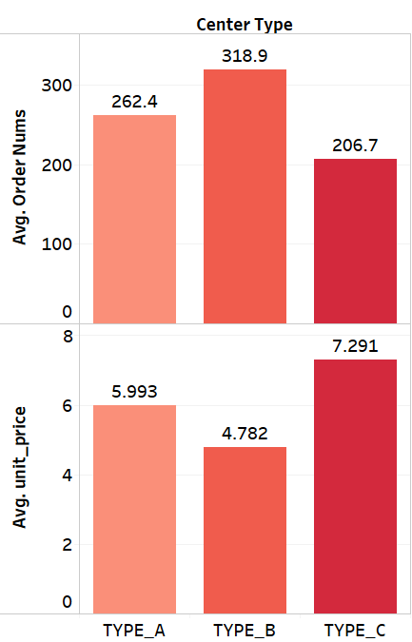
Exploratory Data Analysis: by Center
3 types, 77 centers
number: type A > type C > type B
8 regions
Type A center in every region
Average area: B > A > C
Order number: B > A > C
Unit price: C > A > B

Slide 9
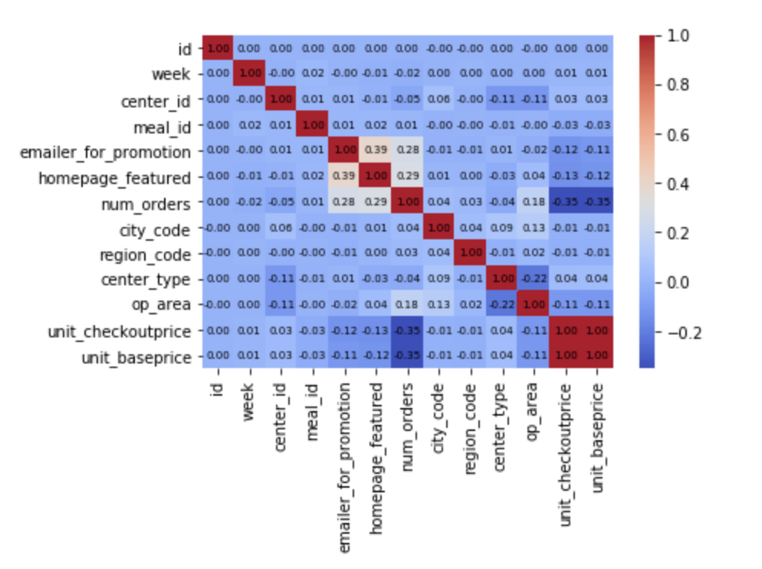
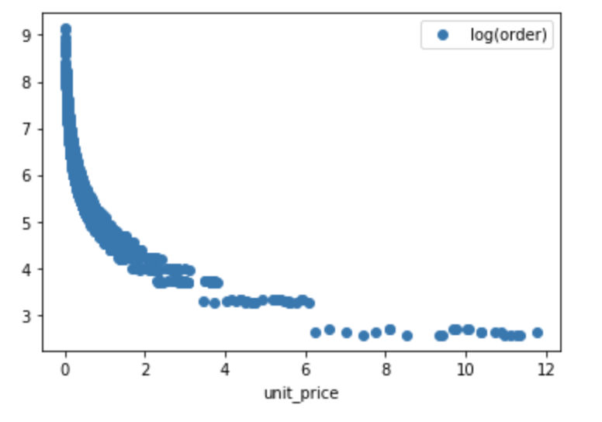
How to build Demand Model
Correlation Matrix
log linear model
Data explanation:
It is shown that the number of orders is highly correlated with unit price, emailer promotion, homepage featured, and op_ area.
The relationship between unit checkout price and number of orders, we will run a log linear model
Notes:
*Unit_checkoutprice = checkout_price / num_orders
*Unit_baseprice = base_price / num_orders

Slide 10
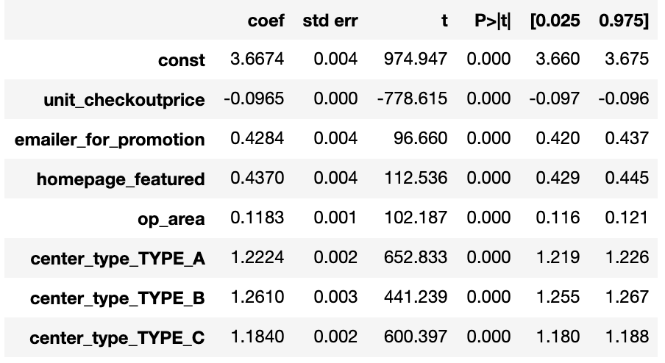
Demand Model
center_type A, B, C as dummy variables type_A, type_B and type_C​
Emailer_for_promotion, homepage_featured are binary variables
Log(num_orders) ​is dependent variable
Log(D) = β₀ + β₁ unit_checkout_price + β₂ promotion + β₃ featured + β₄ area + β₅ type_A + β₆ type_B + β₇ type_C

Slide 11
Model for Cuisines
Cuisines | Model | Price Coff. | R-square
Thai | Log(D) = 3.8 - 0.19*unitprice + 0.16*promotion + 0.61*featured + 0.11*area + 1.26*type_A + 1.42*type_B + 1.11*type_C | -0.1857 | 0.694
Italian | Log(D) = 3.8 - 0.13*unitprice + 0.42*promotion + 0.41*featured + 0.17*area + 1.25*type_A + 1.19*type_B + 1.35*type_C | -0.1327 | 0.667
Indian | Log(D) = 3.66 - 0.1*unitprice + 0.85*promotion + 0.19*featured + 0.09*area + 1.2*type_A + 1.25*type_B + 1.21*type_C | -0.0952 | 0.642
Continental | Log(D) =3.56 - 0.06*unitprice + 0.39*promotion + 0.49*featured + 0.08*area + 1.19*type_A + 1.09*type_B + 1.28*type_C | -0.0641 | 0.768
Data explanation:
The coefficient on unit price for Continental, Indian, Italian, Thai food are 0.06 < 0.1< 0.13 < 0.19 respectively, we can conclude that the Thai food is more price sensitivity than others.
Notes:
Promotion: indian food is more effective
Thai food: more sales in center typeB, have feature

Slide 12
Price Sensitivity for Categories
Coefficient of Unit Checkout Price
Beverage
Desert
Fish
Pasta
Rice Bowl
Sandwich
Soup
-0.17 | -0.67 | -0.06 | -0.07 | -0.34 | -0.3 | -0.15
Biryani
Extras
Other Snacks
Pizza
Salad
Seafood
Starters
-0.05 | -0.19 | -0.14 | -0.08 | -0.32 | -0.04 | -0.14
Data explanation:
Desert has the largest price sensitivity, price increase by $1, the demand decrease by 67%
Seafood has the smallest price sensitivity, demand change by 4% with the price goes up $1.

Slide 13
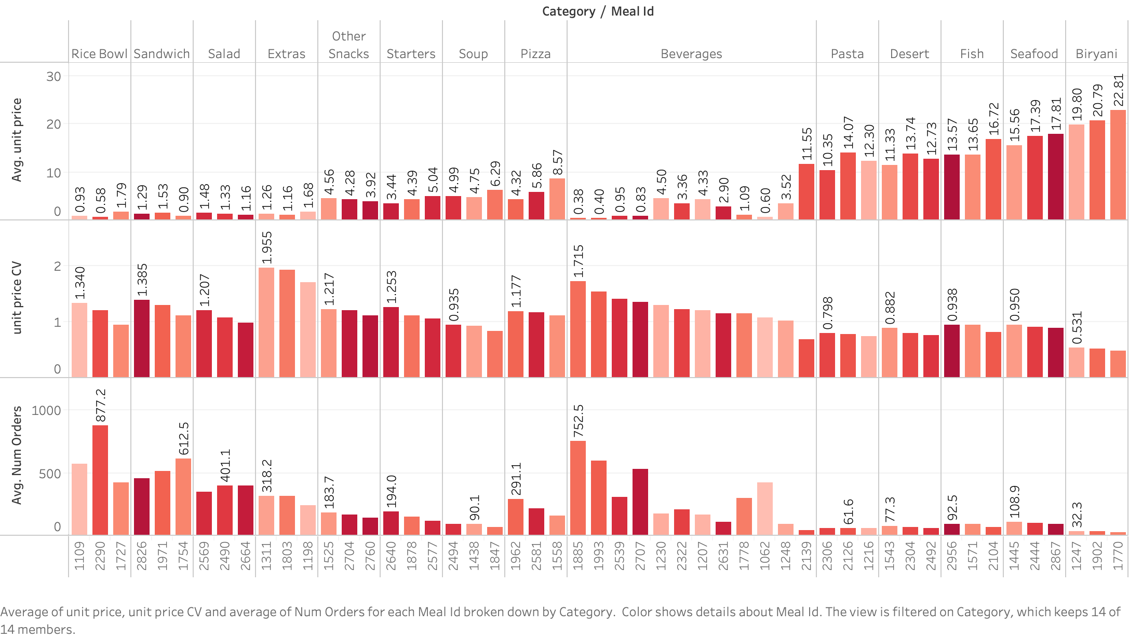
Item Selection
We choose three items with the highest price coefficient of variation in different unit level and categories
Beverage : Meal id 1885 ($0.17), Starters: Meal id 2640($3.44), Desert: Meal id 1543($11.33)

Slide 14
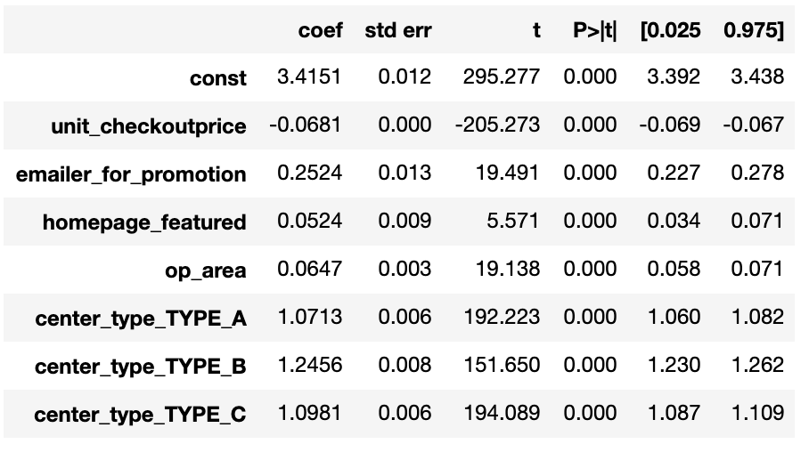
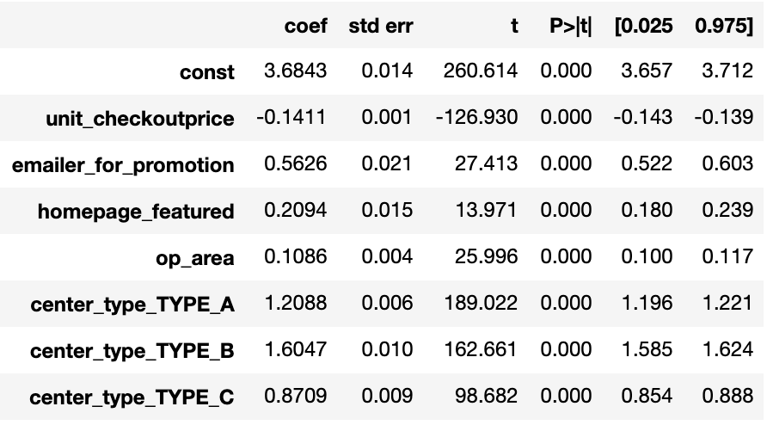
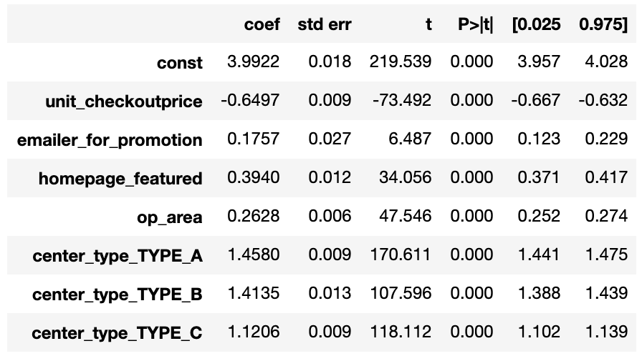
Item Based Model
Desert - 1543
Starters - 2640
Beverage - 1885
R-square: 0.842
R-square:0.822
R-square: 0.662

Slide 15
Revenue Optimization
Assuming that we apply model
With only Center Type A, which has an average operation area of 4.08
No promotion notice
No homepage feature
The number of orders would be
Beverage-1885: Log(D) = 3.99 – 0.65*unit_price + 0.26*4.08 + 1.46*1
Soup-1438: Log(D) = 3.50 – 0.16*unit_price + 0.06*4.08 + 1.17*1
Desert-1543: Log(D) = 3.42 – 0.07*unit_price + 0.06*4.08 + 1.07*1
Meal id | Optimal Price | demand | Optimal Revenue | Current revenue | Percentage of change
1885 | 1.54 | 247.35 | 380.54 | 204.83 | +85.78%
1438 | 7.09 | 75.75 | 536.83 | 412.96 | +29.99%
1543 | 14.68 | 42.56 | 624.83 | 778.64 | -19.75%
Notes:
Fish-2956: Log(D) = 2.86 – 0.60*unit_price + 0.15*4.08 + 0.85*1

Slide 16
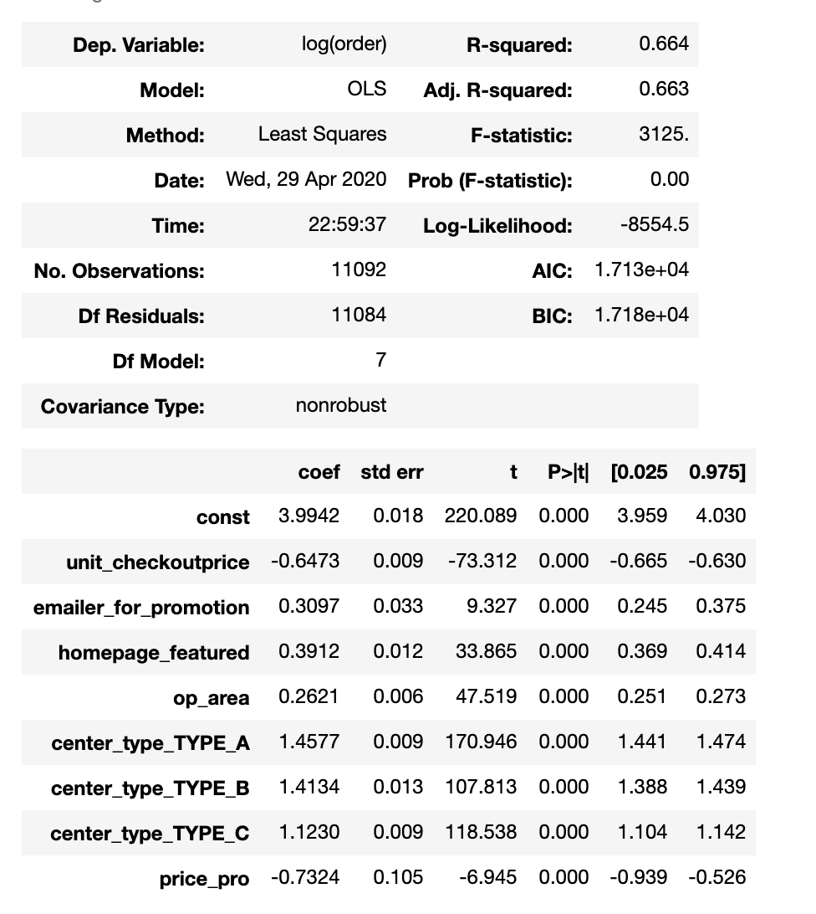
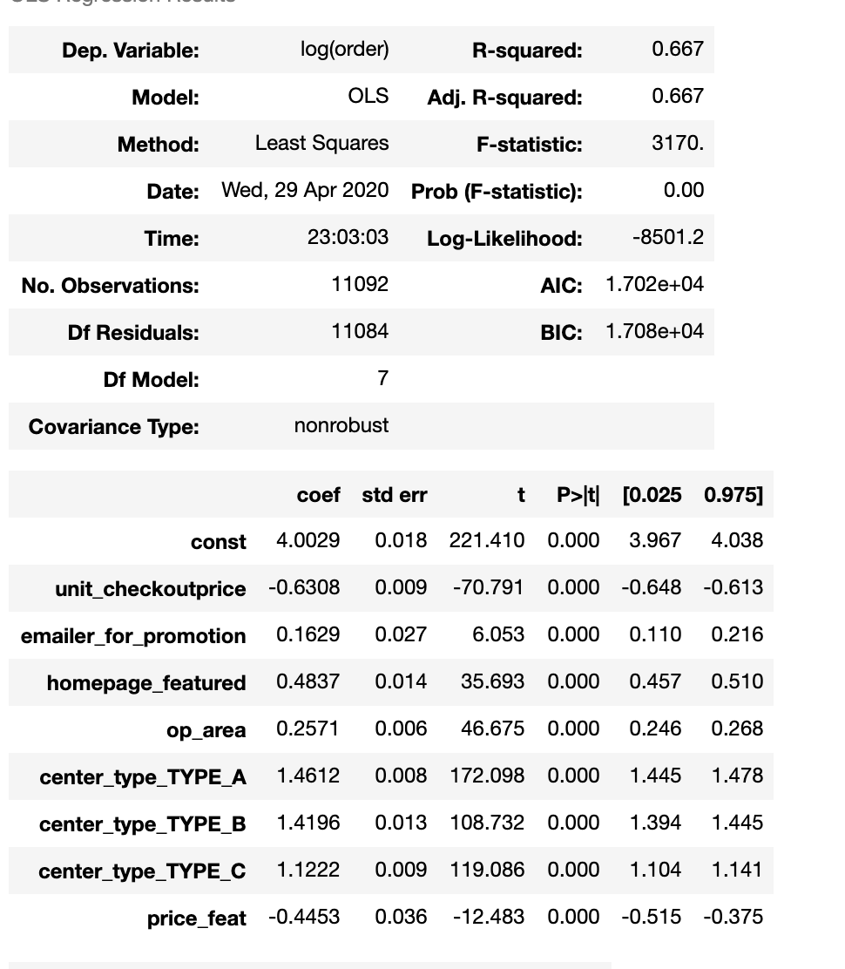
Model Evaluation
Beverage – 1885
Interaction Effect
Model | NO interaction | Add unit_price * emailer_for_promotion | Add unit_price * homepage_featured
Significant at 1% level | / | yes | yes
Adj.R^2 | 0.662 | 0.663 | 0.667
MSE | 0.2740 | 0.2726 | 0.269
Price_pro = unit_price * Emailer_for_promotion
Price_feat = unit _price * homepage_featured

Slide 17
Business Insights
Item specific cost-efficient business investments
Emailer promotion
Homepage feature
Center type
Future implication due to Covid-19
Possible partnership with other operators from the industry
Notes:
Covid-19 impact to the business, might want to consider b2c
Can they optimize the contribution by consolidating goods and service with other operators in the industry?
What innovative technologies should we have to minimize the cost of processing, delivering and storing the meals?

Slide 18
Limitation
Revenue optimization for the most part
Unit Checkout Price vs. Unit Base Price
Center Information, Possible Multicollinearity
Omitted Variable Bias
Notes:
Operation cost such as raw material, overheads and logistics were not given to us for which we can only optimize our revenue for the most part, but high revenue does not necessarily imply profitability.
Unit Checkout Price >< Unit Base Price, noisey data, low model fit
Data provided mainly focus on centers and location, if include them, can possibly have multicollinearity present.
Few other variables were provided besides Prices and number of orders that prevents to better estimate the model parameters, which can cause our model to have Omitted Variable Bias, adj. r square(model fitness). Inflated coefficient estimate , absor effect of Omitted Variable.

Slide 19
Thank You For Your Attention

